Slide 1
Experimental Design
Considerations and Review
Alli Westover

Slide 2
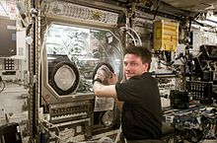
Why Experiment in SPACE?
Unique conditions present in low earth orbit
Primary fields of research
Human research
Space medicine
Life sciences
Physical sciences
Astronomy
Meteorology
2005 NASA Authorization Act designated the American segment as a national laboratory

Slide 3
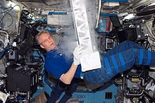
Why Space?
Long Duration missions and effects on the body.
NSBRI (National Space Biomedical Research Institute)
Advanced Diagnostic Ultrasound
Growth and development of living tissues
Physics and study of fluids unique. Fluids can be completely combined in microgravity, they investigate fluids that do not mix well on Earth
Chemical reactions can be slowed by low gravity and temperatures and will give scientists deeper understanding of superconductivity.
Low gravity effects on material science, combustion, emissions and pollutants

Slide 4
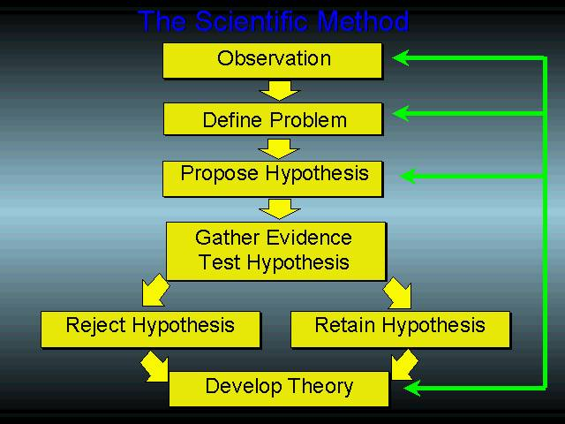
Start with the Scientific Method
Observing a phenomenon that is interesting or puzzling
Making a guess as to the explanation of the phenomenon
Devising a test to show how likely this explanation is to be true of false
Carrying out the test and deciding if the explanation is a good one or not.
Notes:
Recognizable stages: Sometimes the testing will bring to mind another test that might occur to possibly explain the phenomenon better.

Slide 5
Characteristics of Experimental Design
Discrimination
Experiments should be able to differentiate between different hypothesis. Too many hypothesis for same experiment will result in indistinguishable results when tested by poorly designed experiments.
Replication and generality
Experiments must be able to be repeated enough times for the results to be analyzed statistically. Don’t generalize results that may apply to many spectra, especially in biological nature due to natural variability.

Slide 6
Characteristics of Experimental Design
Controls
Experiments must be well controlled. Eliminate all variable factors to induce good results.
Measurements
Measurements are critical and must stay consistent
Important to have accuracy and precision
Keep measurements in Engineering Journal
Notes:
Accuracy: the ability of the method to give an unbiased answer on the average, whereas precision is an index of the method’s reproducibility. Accuracy and precision help you to judege the reliability of the results.

Slide 7
Example
Bean plant experiment
Conclusion
Forty bean plants, growing in pots
Covered one afternoon by individual glass containers
Left in lab over night
Next morning inside of lid of each container were covered in water droplets.
Plants generally give off water vapor.
IS THIS A GOOD CONCLUSION??

Slide 8
What is wrong with Conclusion?
Critique
Explanation
Lack of controls
Conclusion contains some points that are not Valid
Water can come from plants, the soil, the pots, or the air in the jar. Controls should have been put in place.
Experiment done overnight, behavior of plants might be different at other times of day, generally should NEVER be used in a conclusion
No evidence that water is given off as a vapor
What about other plans? Don’t generalize!!

Slide 9
What Makes GOOD Experimental Design?
3 Important steps
Define the Objectives
Devise a strategy
Operational Details
What is the relevance?
Record precisely how you can achieve the objective. Size, structure, subsystems, materials, parts and pieces
Procedures, Length of time to run experiment, specifics of experiment

Slide 10
Remember
Experiments that yield no useful results can be due to inadequate amounts of data collected.
Experiments that seem like they should give useful results but the Procedures were not robust enough.

Slide 11
Controls and Variables
Independent Variable – What is manipulated or the treatment in an experiment
Dependent Variable – is what is observed from the effects of the treatment in an experiment
Controls: factors that remain constant throughout an experiment.
Extraneous Variables – influence the relationship between the independent and dependent variables of an experiment.

Slide 12
Example
A student directly manipulated stress levels in human subjects and measures how those stress levels change heart rate.

Slide 13
Analysis of Experiment Example
Independent variable: STRESS
Dependent Variable: Heart Rate
Controlled Variables: Time of day, temperature, location, males or females only, weight of subjects, type of stress tests, and no food intake for 2 hours.
Extraneous variables - type of food eaten by subjects, how much sleep the subjects had the previous night, and resting heart rate of the subjects.

Slide 14
Hypothesis
Are the independent and dependent variables testable?
Usually an IF, THEN statement
From Research conducted is this experiment a relevant objective? What would it answer? Does it answer the driving question or theory in question?
Driving question is not a yes or no answer, but rather the cause and effect along with being open-ended

Slide 15
Example Hypothesis
Raising the temperature of a cup of water (temp is the independent variable) will increase the amount of sugar that dissolves (amt of sugar is the dependent variable.)
If a plant receives fertilizer (fertilizer is independent variable) then it will grow to be bigger than a plant that does not receive fertilizer (plant size is the dependent variable)

Slide 16
Final Steps in Experimental Design
How is data going to be collected
Procedures for conducting the experiment
Identifying factors that determine if the hypothesis was supported or not supported by experimental findings
Key Point: If the student has developed a deeper understanding of the processes of science experimentation then the student will be able to redesign the experiment for additional testing.

Slide 17
Useful Videos for the Classroom
Experimental Design in Science: Definition &Method
Scientific Method Experimental Design Tutorial for Teachers

