Slide 1





The Center for the Advancement of Science in Space
Manager of the International Space Station U.S. National Laboratory
National Design Challenge Pilot Program

Slide 2

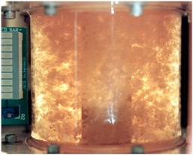
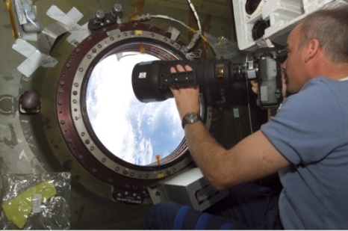
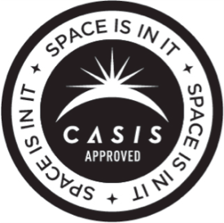
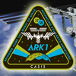
International Space Station
Took 10 years and over 30 missions to assemble; the result of collaboration among 5 space agencies representing 15 countries
CASIS is the nonprofit manager of the International Space Station’s U.S. National Laboratory, supporting non-exploration R&D across a broad range of basic and applied sciences
Cancer cells
Images courtesy of NASA
Notes:
The space station is about the size of a football field: A 460-ton, permanently crewed platform orbiting 240 miles above Earth.
ARK1 mission patch
Jeff Williams, Expedition 13 Science Officer, at the U.S. Laboratory Science Window on station
Bioreactor-cultivated, 5-day human colon cancer cells aboard the space shuttle (STS-70).
Cells grew to 30X the volume of ground controls
Result reproduced on STS-85: mature structures that more closely match those found in human tumors

Slide 3

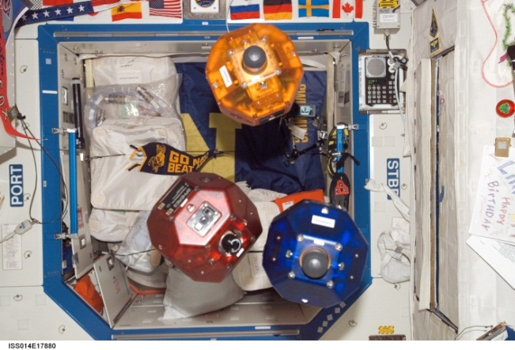
Maximizing value of the ISS
CASIS seeks to maximize the value of the station to the nation
  Fully utilize the Station for basic and applied scientific research
  Inform the general public through outreach on the opportunities and benefits realized through station
Synchronized Position Hold, Engage, Reorient, Experimental Satellites
  Support education efforts that establish the ISS U.S. National Laboratory as a leading laboratory and environment for science, technology, engineering and mathematics (STEM) education.

Slide 4
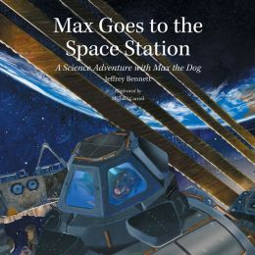
CASIS EDUCATION
Provide access for students and educators to the unique environment of the ISS U.S. National Laboratory, creating an extension to the classroom through real-world science investigations
Build strategic partnerships that promote STEM literacy and ISS awareness through formal and informal educational settings
Reach out to nontraditional demographic groups in novel ways in order to engage students and educators not previously exposed to human spaceflight
Notes:
From an education prospective, CASIS mission is to utilize the ISS NL as the ultimate learning platform for innovative STEM programs.
We use a three-pronged approach that includes;
Providing access for students and educators to the unique environment of the ISS NL.
Building external education strategic partnerships that promote STEM literacy and awareness through formal and informal educational setting
Reaching out to nontraditional demographic groups in novel ways in order to engage students and educators not previously exposed to human spaceflight thereby linking multiple content areas to STEM

Slide 5
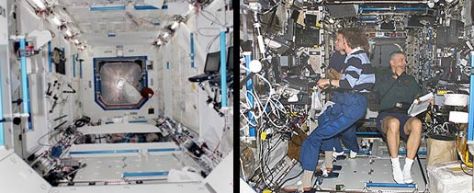
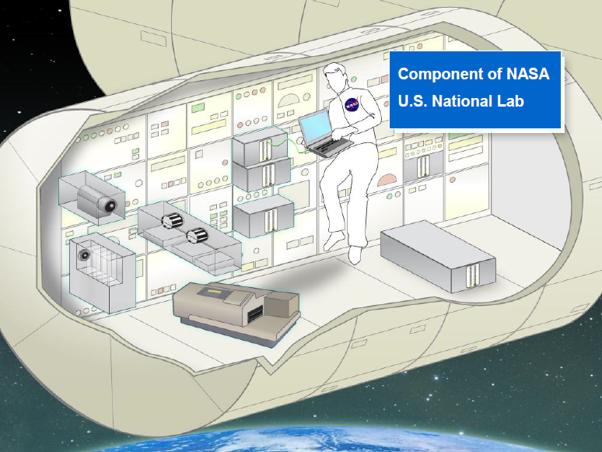
International Space Station
The entire international laboratory is the size of a U.S. football field, with the interior volume of one and a half Boeing 747 jetliners
Inside Destiny: just after installation and after outfitted for research
Artist’s rendition of a space station research area
(courtesy of NanoRacks)
Images courtesy of NASA

Slide 6
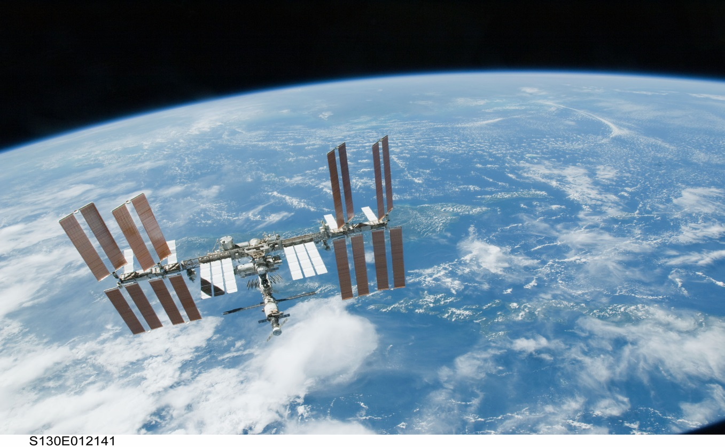
The research environment: low earth orbit
Orbital path over 90% of Earth’s population
Altitude ~240 mi (400 km)
Unique microgravity environment
Image courtesy of NASA
Notes:
Its location in low Earth orbit affords the National Lab a unique vantage point
Benefits for Earth observation data collection: average altitude of 400 km, orbital path covering 90% of Earth’s population
Improved spatial resolution (<6 m) for Earth viewing
Variable lighting conditions for Earth viewing (versus orbiting satellites)
Capability to measure or detect X-ray sources, cosmic rays, solar spectral irradiance and neutron flux in space (e.g., the full cosmic ray spectrum can be studied only from space)
Exploiting this platform for Earth observation and remote sensing of space allows a broad range of studies with equally broad implications for basic and applied science across many fields. For example:
The ability to measure solar energy irradiance into Earth’s atmosphere reveals the effects of this irradiance on atmospheric modeling, atmospheric chemistry and climatology
The capability to measure or detect X-ray sources, cosmic rays, solar spectral irradiance and neutron flux in space allows studies not possible on Earth
Images:
MAXI is a highly sensitive X-ray slit camera externally-mounted to the International Space Station for monitoring more than 1,000 X-ray sources in space, including black holes and neutron stars. In 2010, MAXI found two new X-ray sources from its sky scans
SMILES made atmospheric observations in 2009/2010 with the aid of a 4 K mechanical cooler and superconducting mixers for submillimeter limb‐emission sounding in the frequency bands of 624.32–626.32 GHz and 649.12–650.32 GHz
On the basis of the observed spectra, the data processing has been retrieving vertical profiles for the atmospheric minor constituents in the middle atmosphere, such as O3 with isotopes, HCl, ClO, HO2, BrO, and HNO3. Globally mapped ozone distributions at 28 km on 12 October 2009. Original observation points are plotted by white circles with observed ozone mixing ratios.
SUCCESS STORIES:
The ISS houses the first space-based method of tracking global maritime traffic, capable of autonomously monitoring ships’ speed, position, course, cargo and voyage information in open waters (versus Earth-based systems, which can only monitor coastal waters).
Earth Observation capabilities on station have been used to aid in disaster recovery efforts after, for example, a volcanic eruption or the 2011 Japanese tsunami. They have also been used to monitor global environmental hazard risks, such as the melting of glaciers that caused a Russian avalanche in 2002.
In 2010, two new X-ray sources were identified in space using two facilities on station:
Monitor of All-sky X-ray Image (MAXI), which is
comprised of a couple highly sensitive
X-ray detectors, the Gas Slit Camera and
the Solid-state Slit Camera
Swift, a first-of-its-kind multi-wavelength
observatory dedicated to the study of
gamma-ray bursts (GRB) and other transients

Slide 7
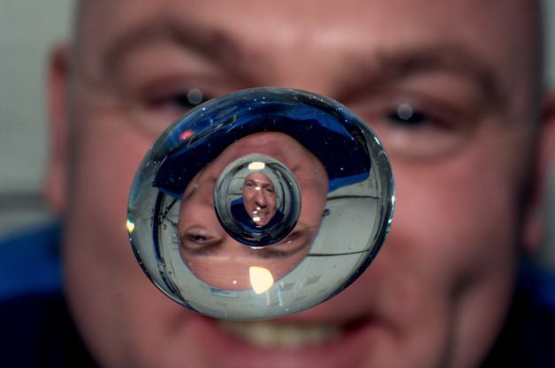
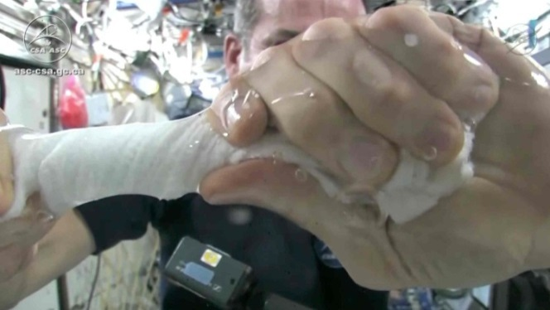
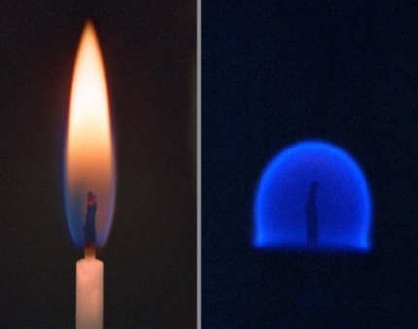
Why send research into space?
Unique microgravity environment alters many observable phenomena
Flame structure in space
Chris Hadfield, CSA
Andre Kuipers, NASA
Earth
Space
Images courtesy of NASA
Notes:
In this image provided by NASA astronaut Andre Kuipers watches a bubble in a drop of water as he enjoys the last days of weightlessness. The photo was taken June 24, 2012.

Slide 8
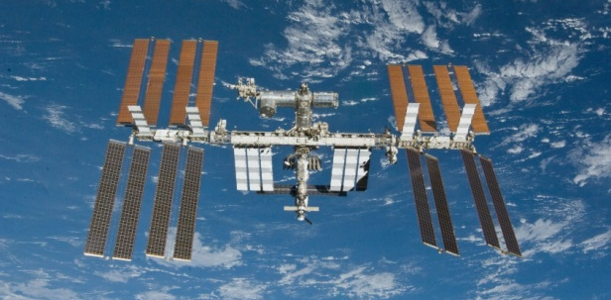
CASIS National design challenge Pilot program
The CASIS National Design Challenge (NDC) will engage educators in inquiry based scientific and engineering practices by designing and building an experiment to be flown on the ISS U.S. National Lab
The initial pilot program will take place in three Houston, TX schools: Awty International School, Cristo Rey Jesuit College Preparatory School and Duchesne Academy of the Sacred Heart School
The NDC Pilot Program will serve as a “proof of concept” that could be duplicated in other areas of the country before implementing on a national level

Slide 9
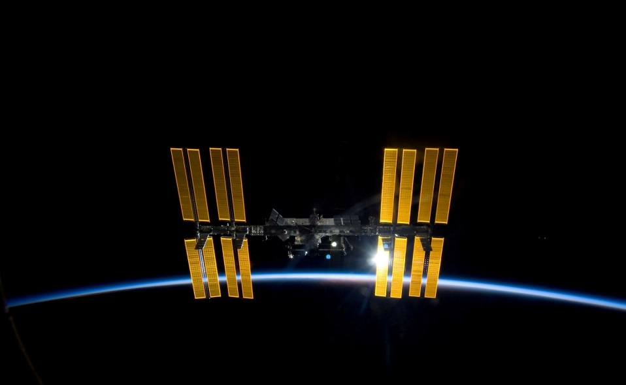
Where do we start?
Designate a main POC for your school
Purchase ArduLabs and 6 months of technical support from Infinity Aerospace with CASIS grant funds
Attend Professional Development Workshops provided by CASIS and our industry partners
Design experiment to fit inside a 1U ArduLab
Sensors, actuators, etc. can be purchased from Spark Fun Electronics with CASIS grant funds
ASK LOTS OF QUESTIONS!
Provide feedback

Slide 10
Professional Development
Allison (Alli) Westover, a local Houston teacher, will be providing professional development for teachers on topics such as microgravity research, experimental design, engineering design and the flight integration process
Alli will be the main program POC in the Houston area – she is the CASIS Professional Development Mentor and will be able to assist you through the entire process
Spark Fun Electronics Education Team will be in Houston on September 5th and 6th to provide all day training to teachers on Arduino technology and sensors
Infinity Aerospace staff are available for technical support

Slide 11
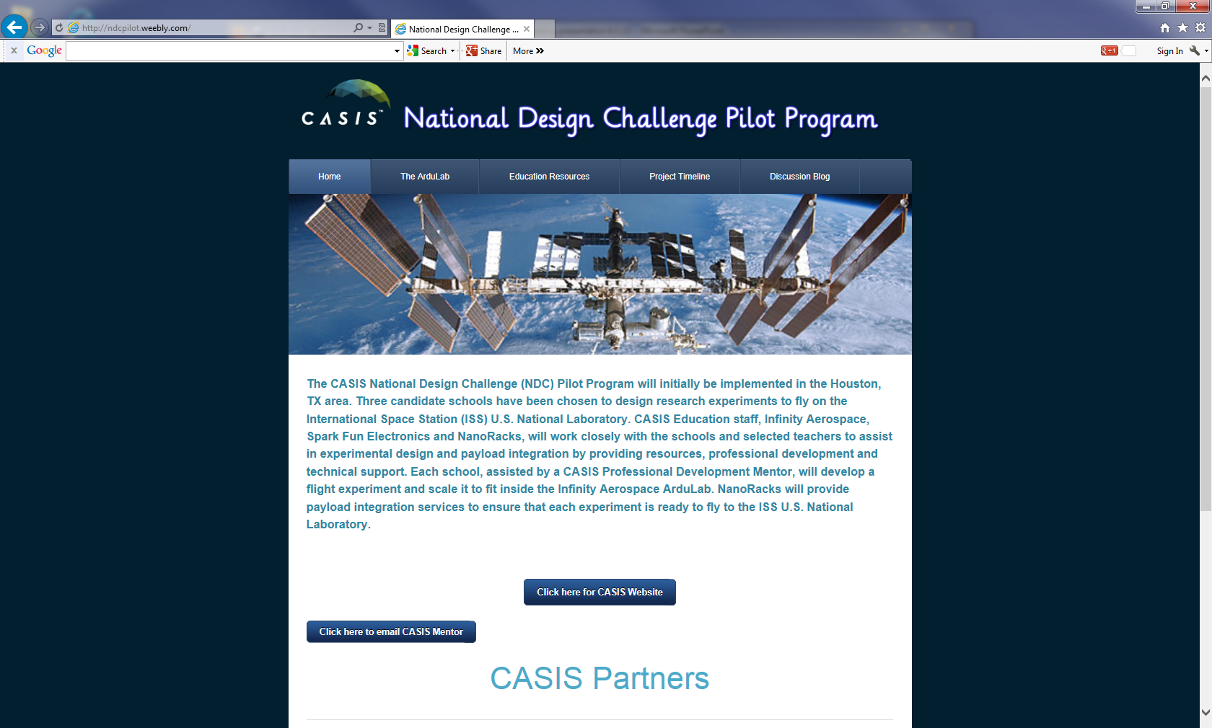
NDC Pilot Program website
Website: http://ndcpilot.weebly.com

Slide 12
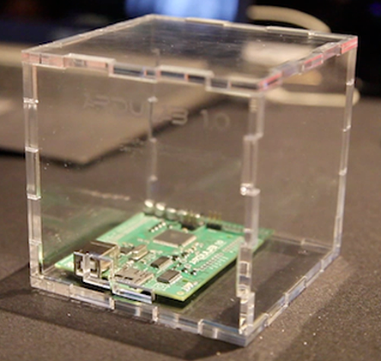

The ardulab
IU cubesat form container
Open source using Arduino technology with “plug and play” sensors
Programmable micro-controller, allowing automation, control, and data collection
Notes:
Designed to be open source using Arduino based technology with “plug and play” sensors
Platform includes a simple programmable micro-controller, allowing automation, control, and data collection of the experiment (lessening the amount of crew time)
Easy to integrate and control hundreds of different analog & digital sensors, stepper motors, cameras, lights, etc. to control and collect data from the experiment on the ISS.

Slide 13
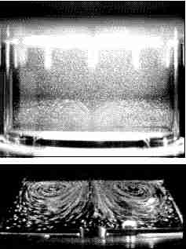
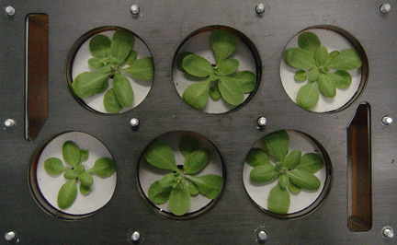
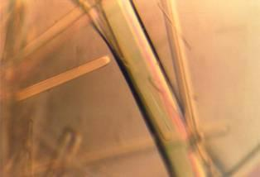
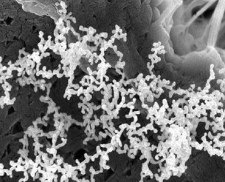
Ideas for space research on the ISS
Fluid Physics
Materials Science
Microbiology
Plant Biology
Protein Crystal Growth
NO hazardous substances
Thermocapillary flows
Plant Generic Bioprocessing Apparatus
Earth
Space
Metal nanoparticles
Nucleosome core particle

Slide 14


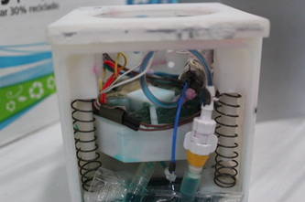
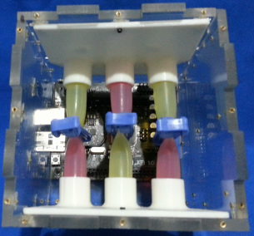
1U Student experiments
Plant experiment
Fluids experiment

Slide 15
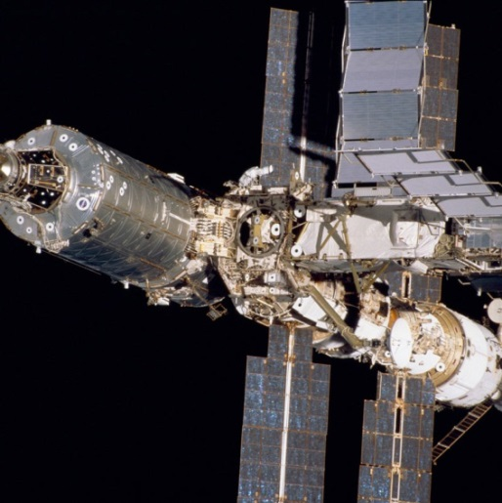
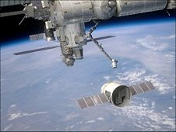
How will my Experiment get into Space?
CASIS is partnering with Infinity Aerospace (hardware developer) and NanoRacks (payload integrator) to send experiments to the ISS National Lab
ArduLabs will be stowed inside the ISS U.S. National Lab in a specially designed rack to hold experiments.
NanoRacks, in concert with CASIS, will provide technical payload integration services as well as assist in coordinating the launch and on-orbit logistical requirements.

Slide 16
Timeline for National Design challenge Pilot Program
Summer/Fall 2013
Fall 2013
Spring2014
Professional development workshops for teachers to conceptualize and design experiments
Complete experiments; payload integration activities with NanoRacks begin
Fly experiments to the National Lab

Slide 17
Introduction to NDC Mentor
Alli Westover
Biomedical Engineer from Texas A&M University
Worked at NASA JSC
  Crew training for science experiments on MIR
  Advanced Projects Lead for future medical hardware
  Preflight and postflight evaluation of crew health
Engineering Design Teacher at Clear Springs High School
  NASA HUNCH: plant growth chamber/other hardware for ISS
  Zero Gravity Flight to test experiment in microgravity
Notes:
Biomedical Engineer from Texas A&M University
Worked at NASA JSC
Crew training for Science Experiments on the Russian MIR Space Station
Advanced Projects Lead for future medical hardware to use on long duration missions
Pre-flight and Post-flight evaluation of the crew’s medical health
Engineering Design Teacher at Clear Springs High School
Worked with NASA HUNCH to produce plant growth chamber and other hardware for the crew to test on the International Space Station.
Students used Zero Gravity Flight to test Experiment in Microgravity environment.

Slide 18
Project Development Timeline
August 28-29, 2013
Staff Development: Experimental Design/Design Process and Project Management
September 2013
Choosing your experiment and designing initial concepts including research
Project team development and Project Management implementation
September 2013
October 2013
Subsystems developed and Final Design Solution Created
October 2013
Acquisition of Materials
Oct/Nov 2013
Initial Prototype of subsystems and entire system including collecting initial data

Slide 19
Continuation of Project Timeline
Nov 2013
Re-design and tweaking of design based on initial prototype issues, potential for more material acquisition
Dec/Jan 2013-2014
Final Prototype development and incremental testing
Jan/Feb 2014
Ground Based Testing
Feb 2014
Finalize Test Experiment Data Package**
Jan-April 2014
Integration Process with NanoRacks
June 2014
Postflight white paper composed including ground based studies and space flight studies
** TEDP will begin at beginning of experiment and you will work on it through the end with specific deadlines .

Slide 20
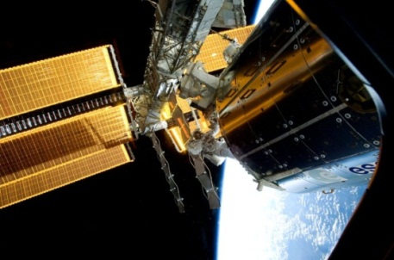
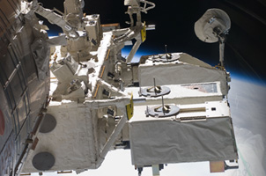
Payload integration
NanoRacks will serve as the “Implementation Partner” for the Pilot Program experiments
This covers:
  NASA Hardware & Software Integration Requirements
  NASA Payload Safety Requirements
  Verification Testing & Analysis
  Flight Readiness Preparation
  Payload Delivery for Launch

Slide 21
Payload integration requirements
NASA is responsible for the overall safety of the ISS and the astronauts on-board
All ISS payloads must demonstrate through analysis, inspection, or testing that the hardware and/or software will interface with the Station without breaking!

Slide 22
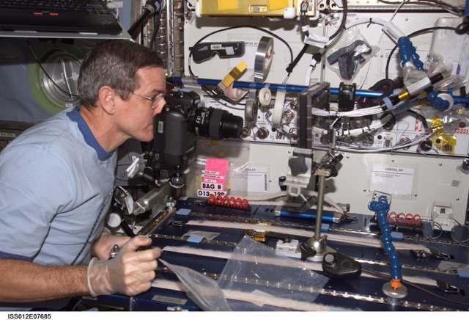
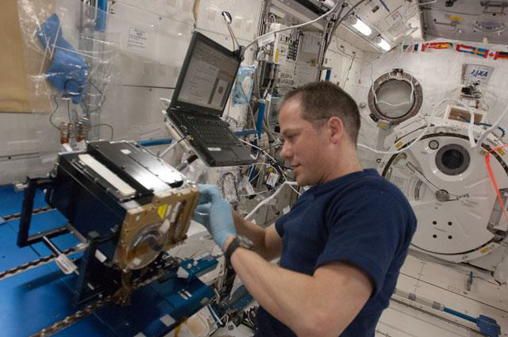
Payload safety
The NASA Payload Safety Review Panel is responsible for ensuring the safety of the crew and the ISS itself are protected
All ISS payloads must demonstrate through analysis, inspection, or testing that any hazards to the safety of the crew or the vehicle itself are removed or controlled

Slide 23
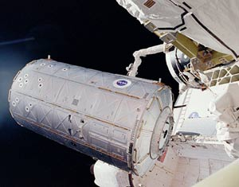
Flight preparation
NASA’s Cargo Mission Services team can accept delivery of soft-stowed payloads from NanoRacks and put them on the next available launch
NanoRacks can also load time-sensitive experiments on the launch vehicle as close as 12 hours before launch
This work involves sample prep and packing for stowage on the launch vehicle
Destiny module

Slide 24
Questions?
www.iss-casis.org
Twitter: @iss_casis

