Slide 1
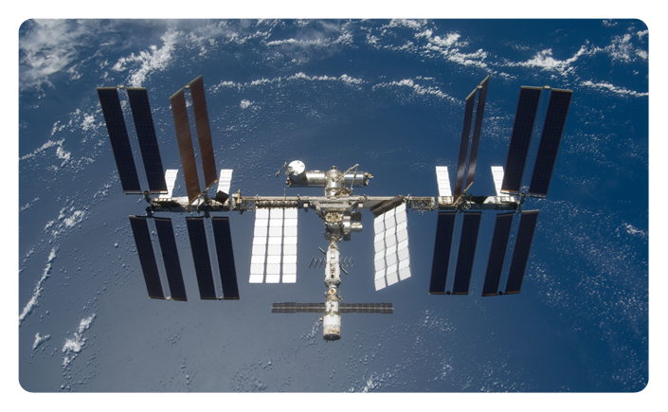
The First Commercial Classroom in Space

Slide 2
First, let’s focus on our target customer....

Slide 3
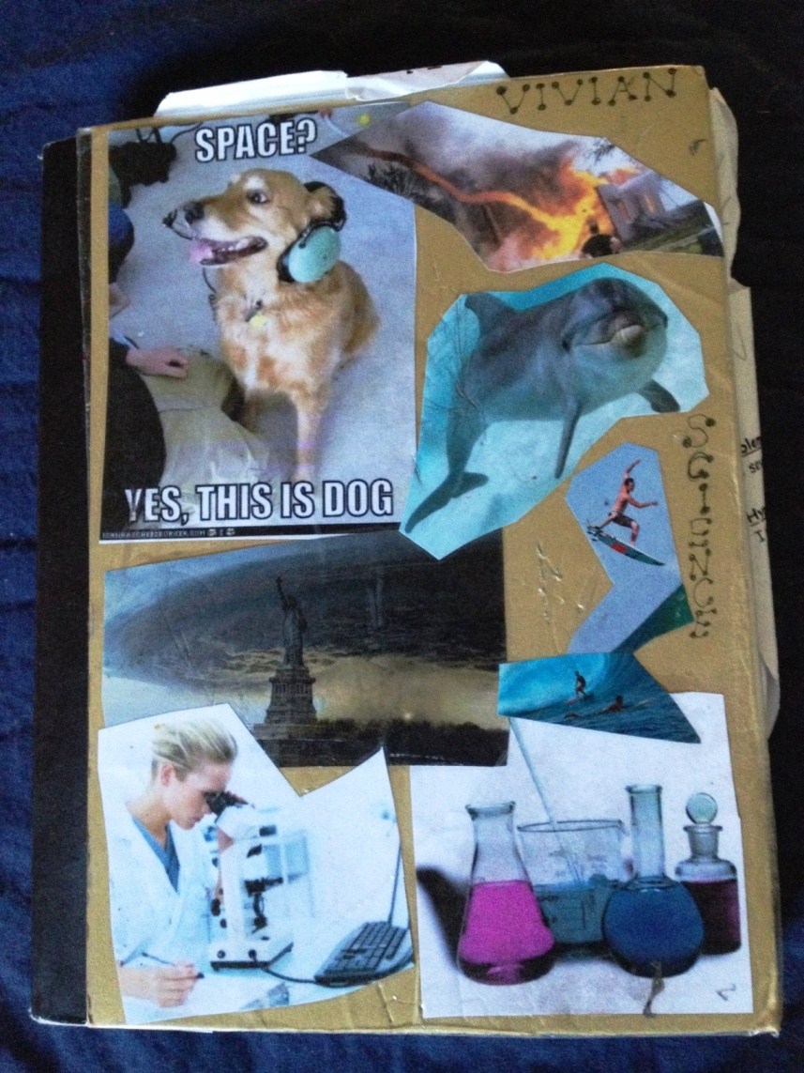
Every student has a science notebook.

Slide 4
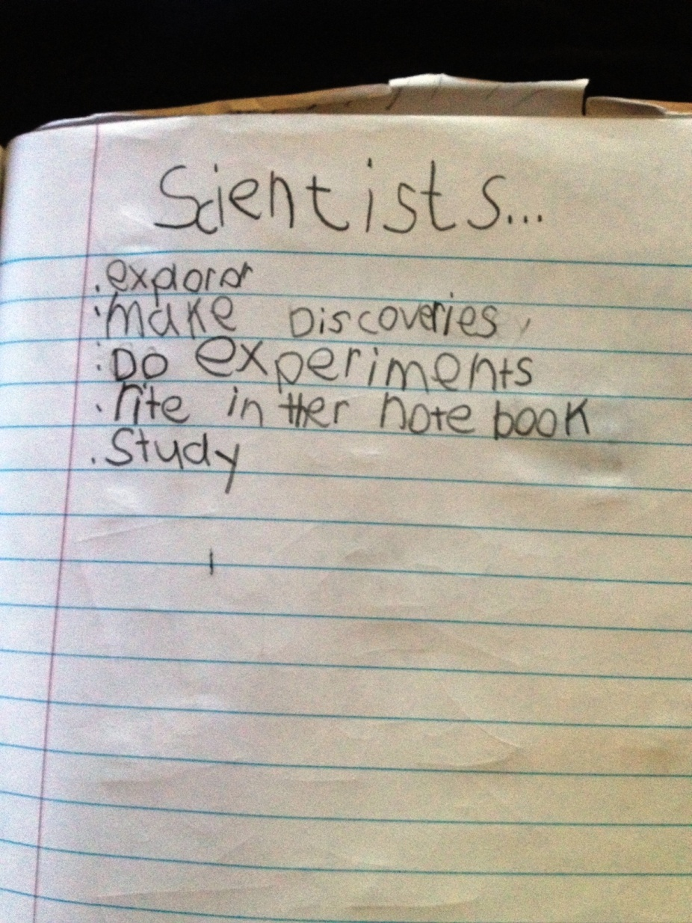
They learn what scientists do.

Slide 5
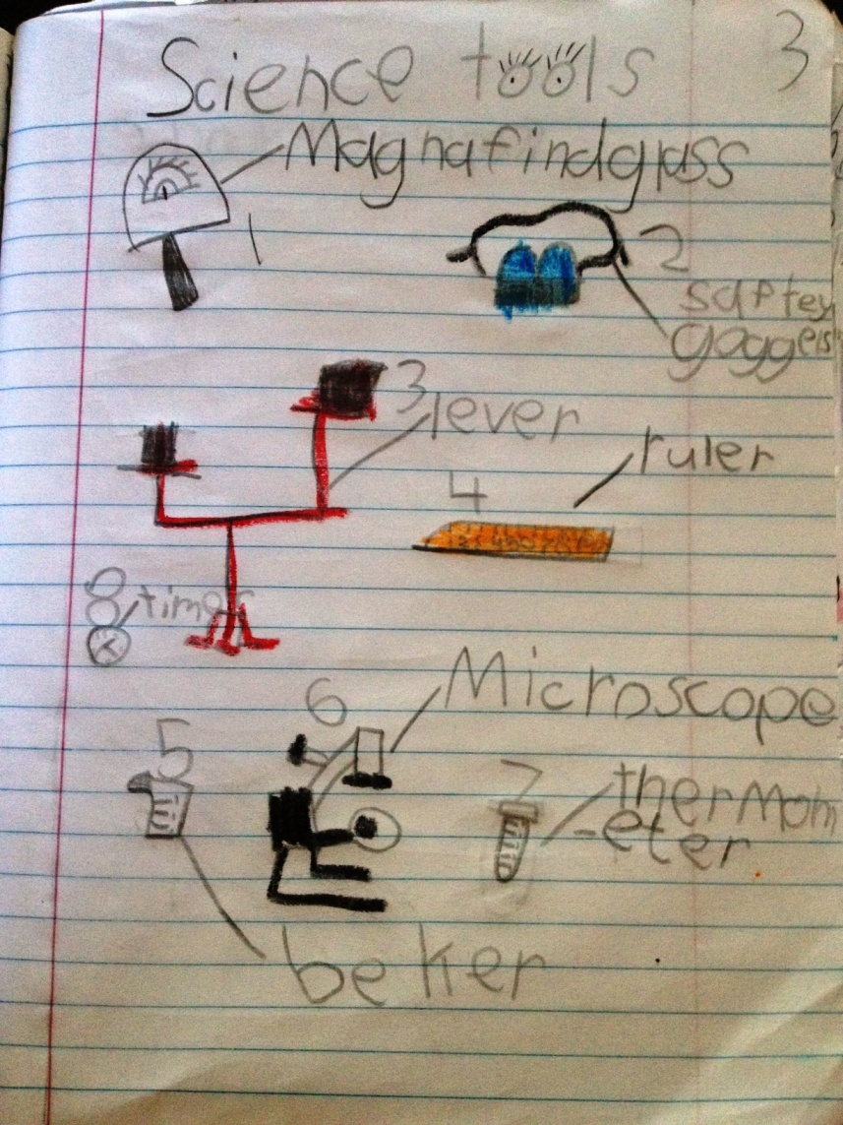
They learn what tools scientists use.

Slide 6
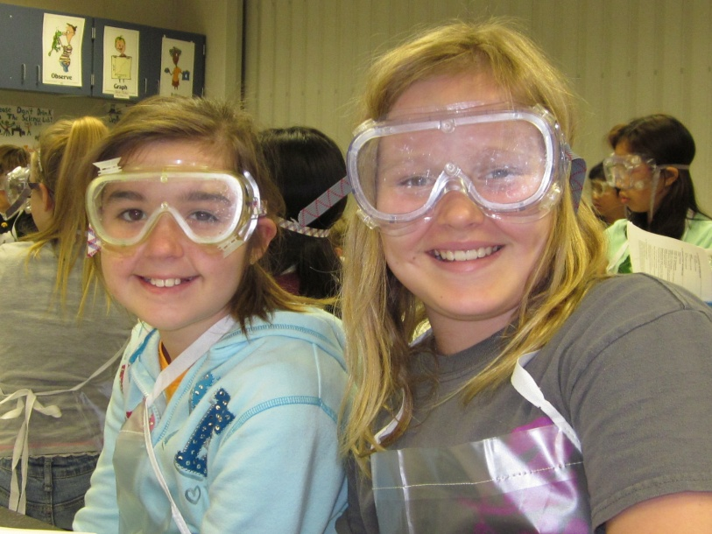
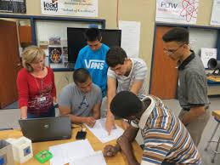
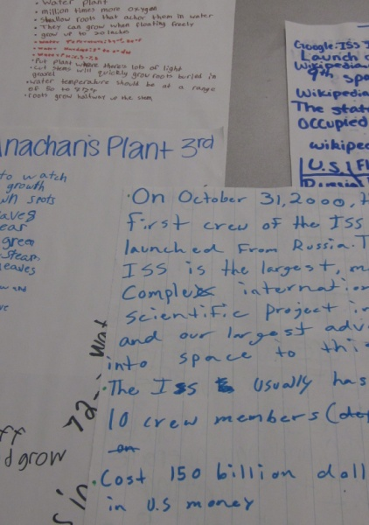
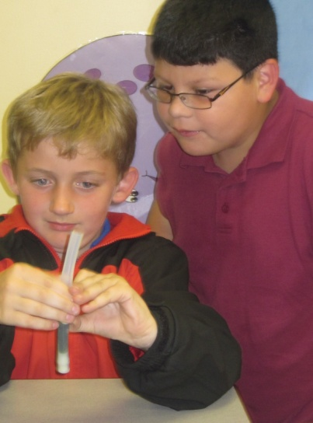
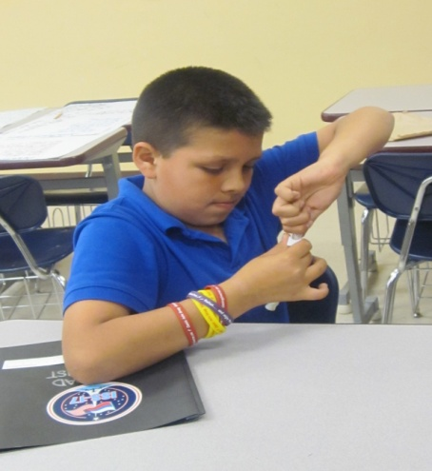
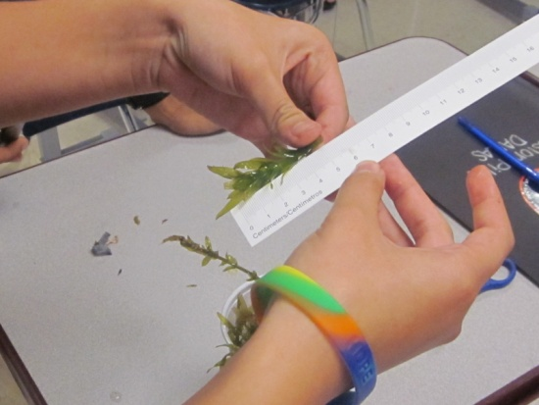
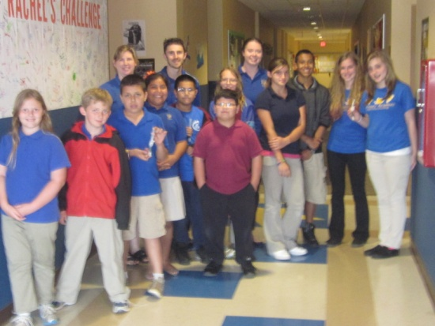
Now every student has this opportunity……

Slide 7
`
NanoRacks , LLC is dedicated to helping stimulate use of low-orbit by having entered into a partnership with NASA that allows us to develop hardware and programs in the U.S. National Laboratory onboard International Space Station. We are unique in having been able to develop, operate and market commercially a family of facilities onboard the U.S. National Lab. Our low prices and commercial practices have put microgravity projects within the budgetary realm of hundreds of universities, smaller organizations and first-time commercial space research users.

Slide 8
An ISS Project via NanoRacks is an interdependence of science, inquiry, engineering, and technology. It can cross-cut curriculum, and is suitable for students in:
Any school or homeschool
Science Club
Boy/Girl Scouts
Chemistry
Physics
Earth and Life Science
Nanotechnology
Biology and Biotechnology

Slide 9
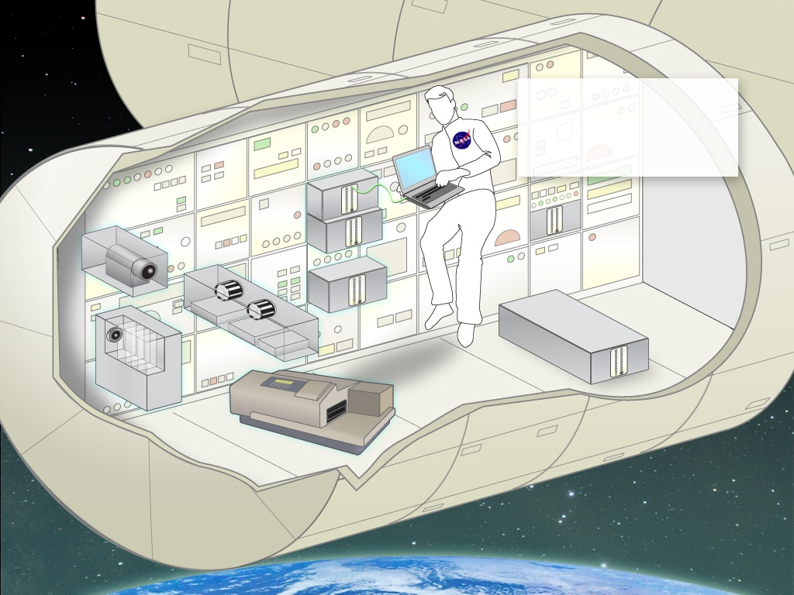
NanoLabs are custom
made to fit the specs of
the U.S. National Lab.
Almost any experiment
that can be done in your
lab can be performed in
microgravity on the ISS.
.
Notes:
9
9
9

Slide 10
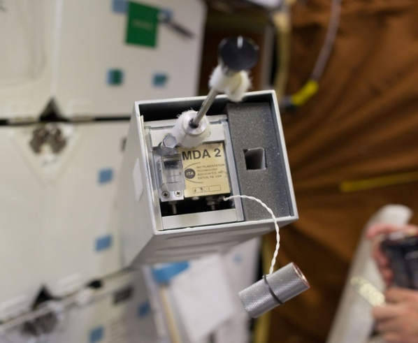
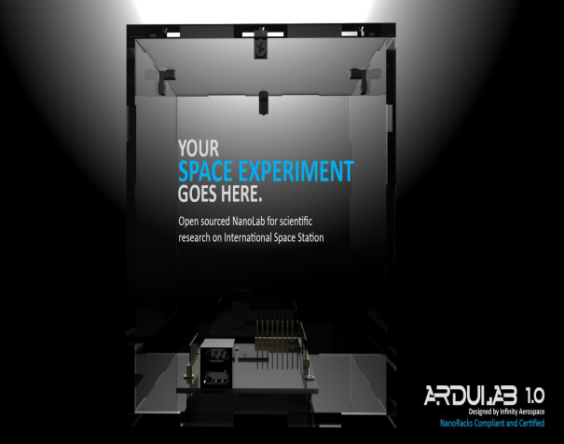
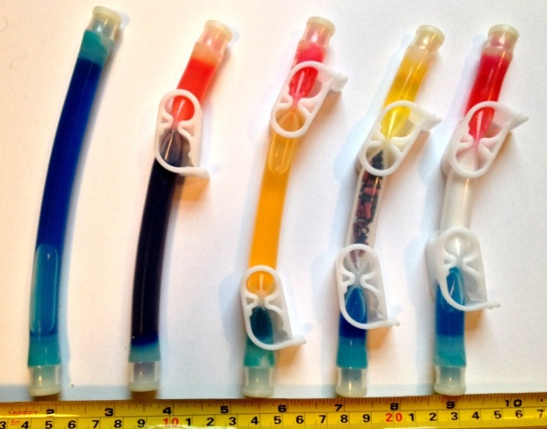
Products Our Clients Use
NanoLab Ardulab 1.0 Mixture Tubes

Slide 11
Benefits of Our Programs to Students
Engineering experience
Project management skills
Science education growth
Incidental Learning
Mentors from the Community
Opportunities to Present Findings
A Memorable and Hopefully Exciting Experience

Slide 12
NanoRacks, LLC is happy to participate in the
CASIS National Design Challenge Pilot Program and
make it possible for your students’ projects to get to space.

Slide 13
