Slide 1
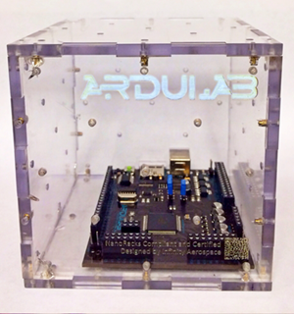
The Effects of Microgravity and Light Wavelength on Plant Growth in an ArduLab
Duchesne Academy of the Sacred Heart 8th Grade
2013-2014

Slide 2
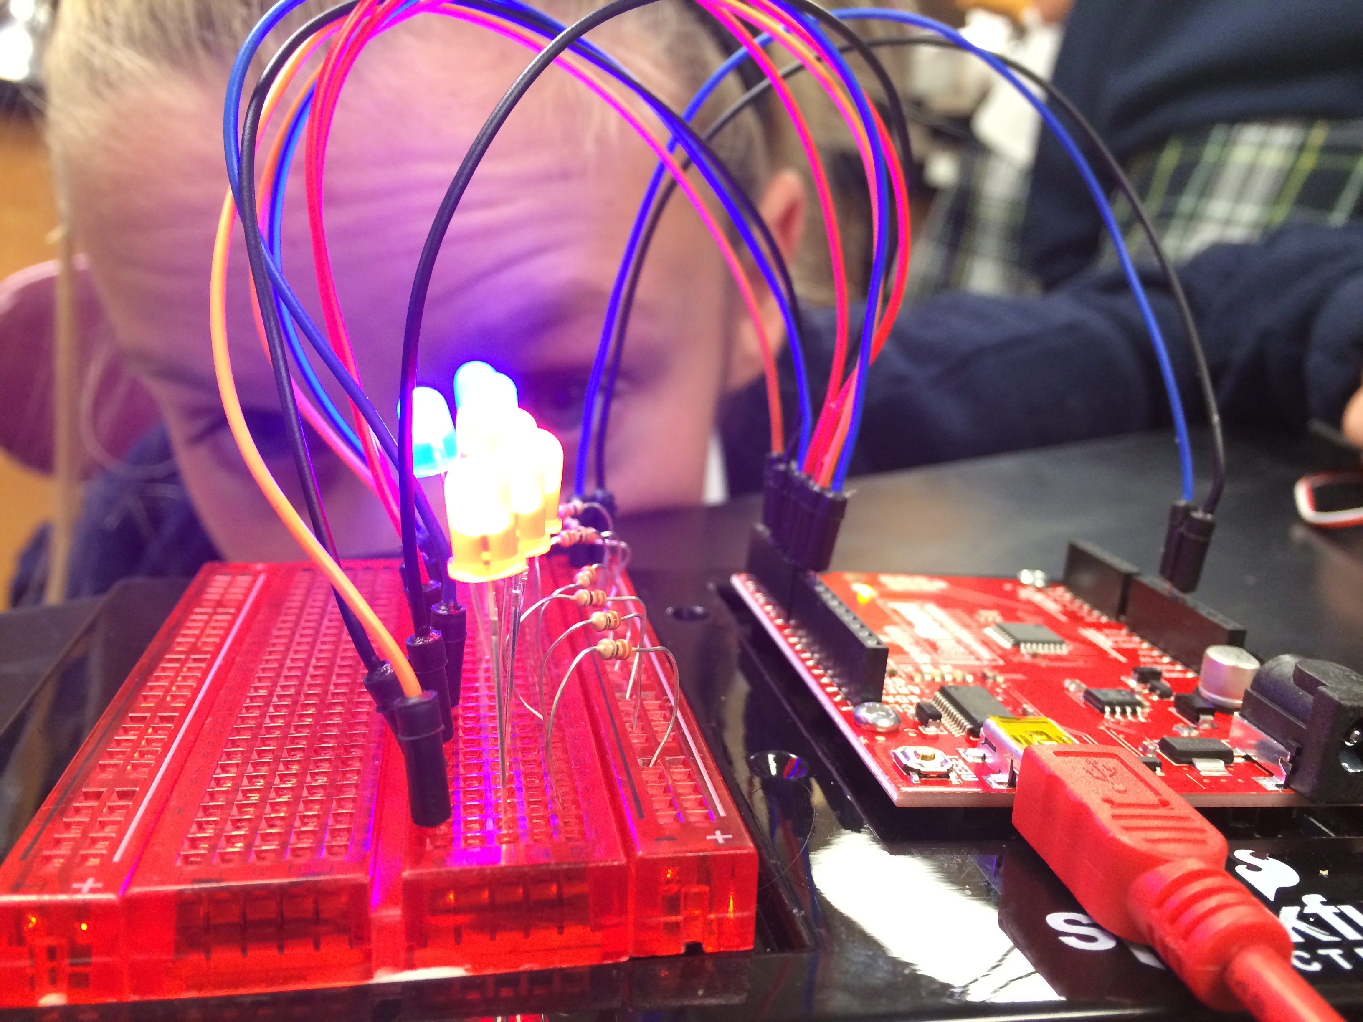
Hypothesis
If pea shoots are exposed to microgravity and different combinations of red and blue light wavelengths, then the plants will demonstrate the most growth on the side with the ratio of three red to one blue super-bright LED light, because red light has the longest wavelength, is bent the least, and moves the slowest, so the plant would be able to absorb the light more effectively.

Slide 3
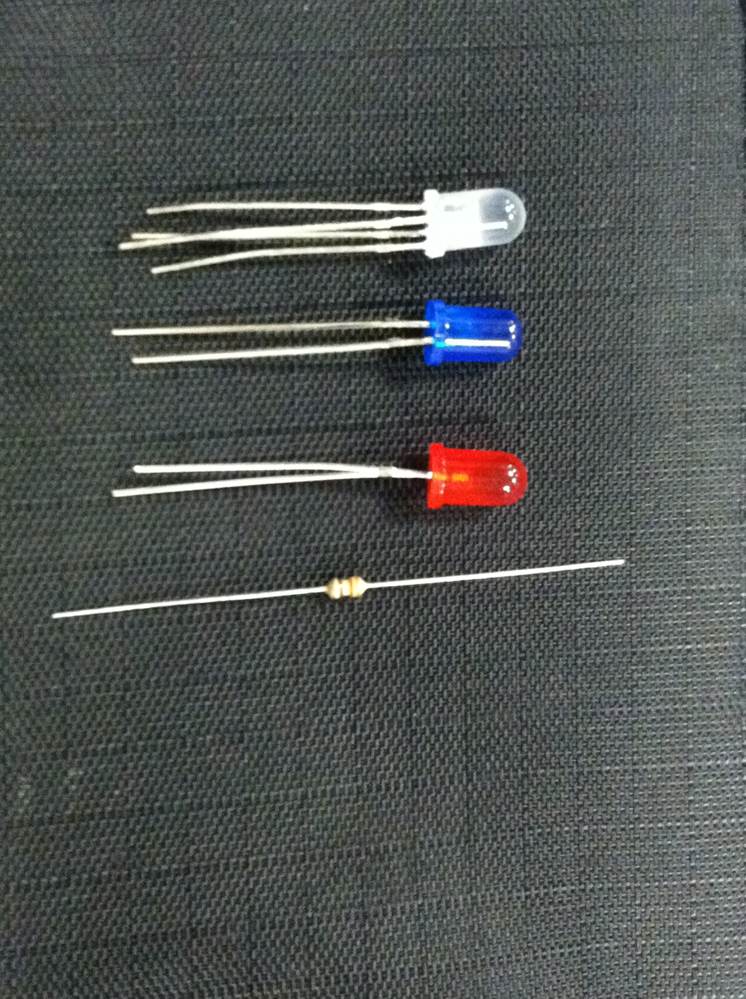
Investigation, Goals, and Objectives
Our investigation is to discover which variation of blue and red wavelengths will cause pea shoots to grow the fastest in a microgravity environment
Our objective is to learn more about the effects of light wavelength and microgravity on plant growth through our research and experiment
Our final goal is for our research to help the advancement of plant growth and food production for long-duration space flight

Slide 4
Measurements Approach
We plan to measure the growth of the plants through a grid system put on the divider and the walls of the ArduLab
The grid will be marked off in 2 millimeter increments
The cameras will photograph the progress three times every day while on the ISS

Slide 5
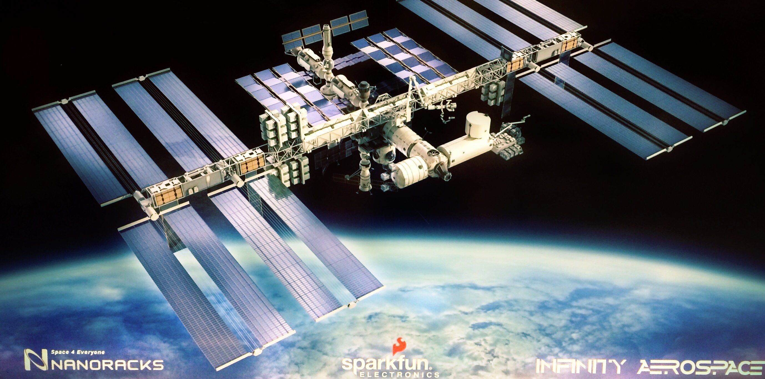
Importance and Reason for ISS
Our experiment is important for the advancement of plant growth in space for long-duration space flight
The ISS is now a national laboratory and the only location where it would be feasible to conduct this experiment

Slide 6
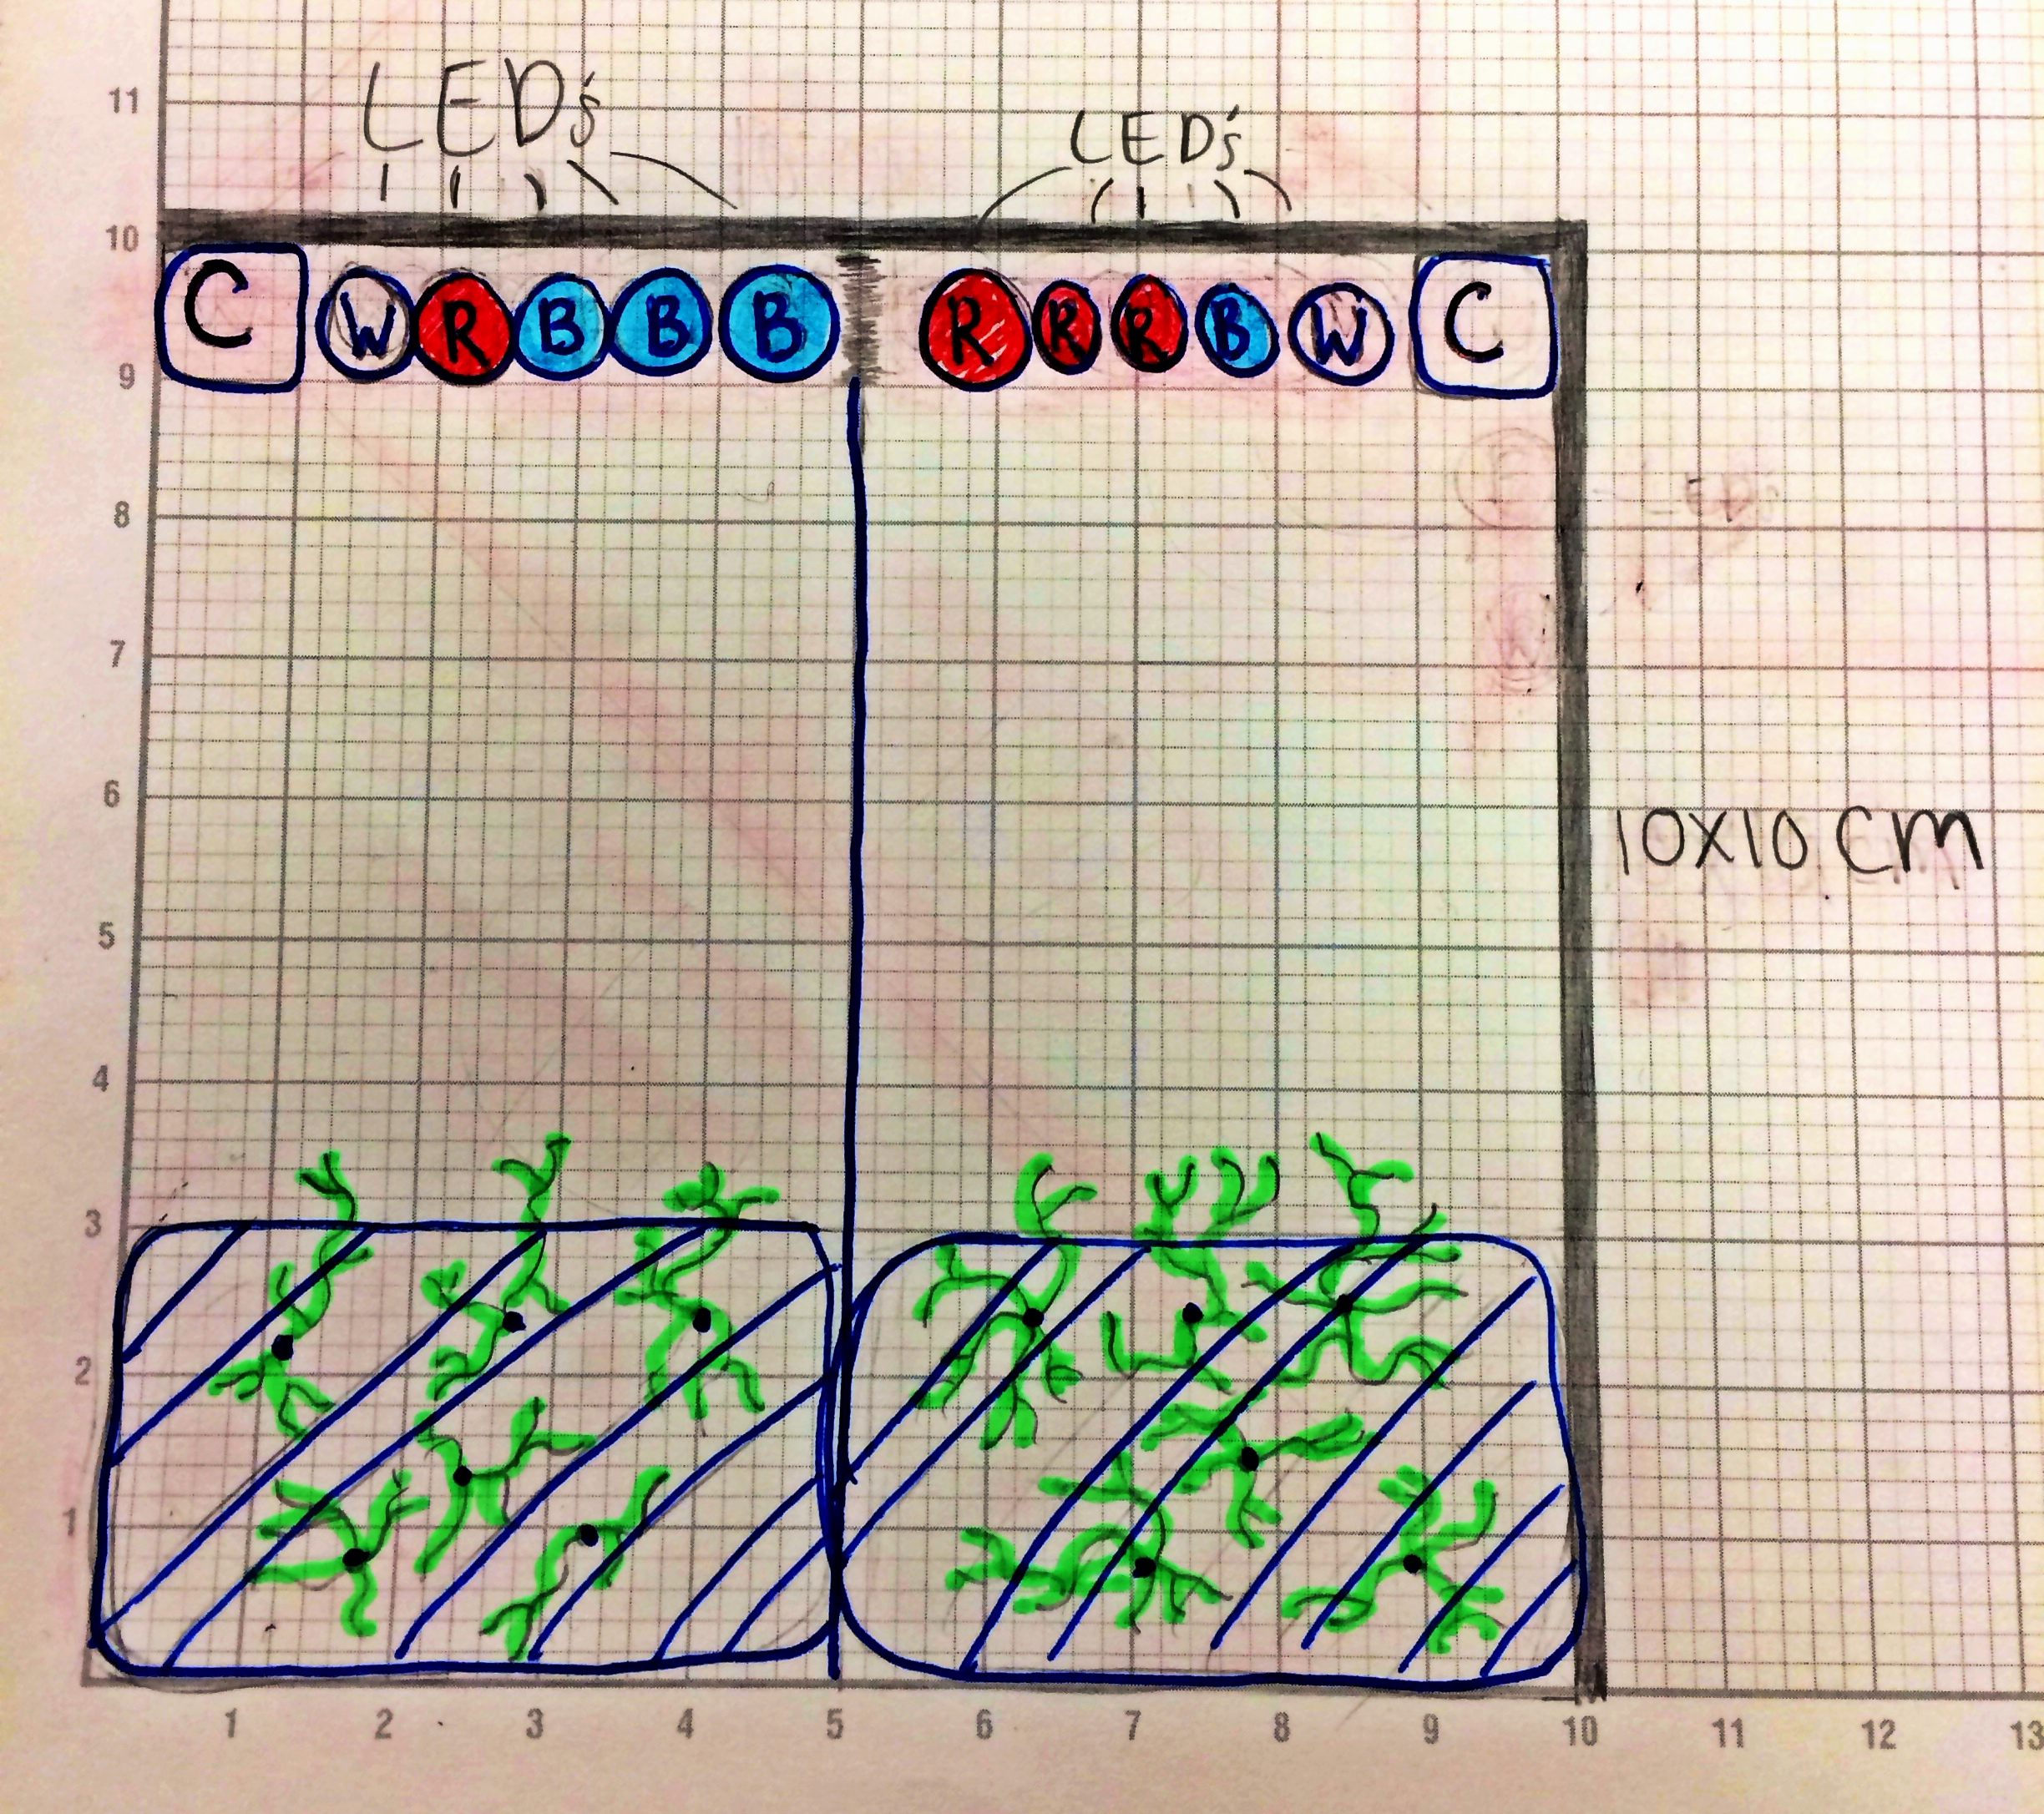
Expected Results and how they will Advance the Field
We expect that the plants will germinate and grow on both sides of the ArduLab
The shoots will grow towards the lights
The roots will spread out in all directions
It will help in creating space gardens and using the least amount of energy to produce the greatest amount of edible plants

Slide 7
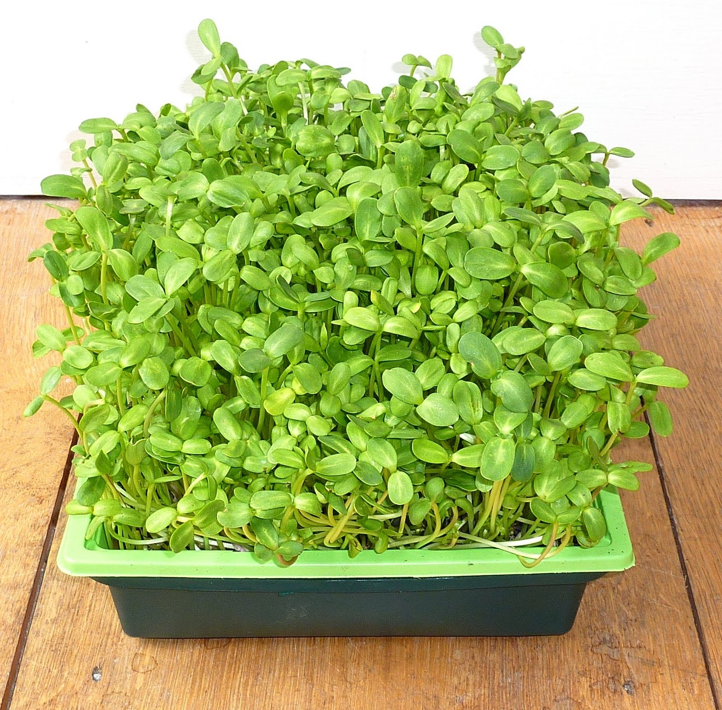
Earth Benefits and Spin-off Applications
Our data will benefit people all over the world without adequate sunlight by giving them a different option for growing plants
This experiment will assist with crop production in greenhouses by informing people which lights would be the most beneficial in growing plants

