Slide 1
www.infinityaerospace.io
#makersinspace @ardulab

Slide 2
MANU SHARMA, Co-Founder
Aerospace Engineer Stanford University | Singularity University | Embry-Riddle
Who are we?
BRIAN RIEGER , Co-Founder
Aerospace Engineer Boeing 787 Aerodynamicist | Embry-Riddle

Slide 4
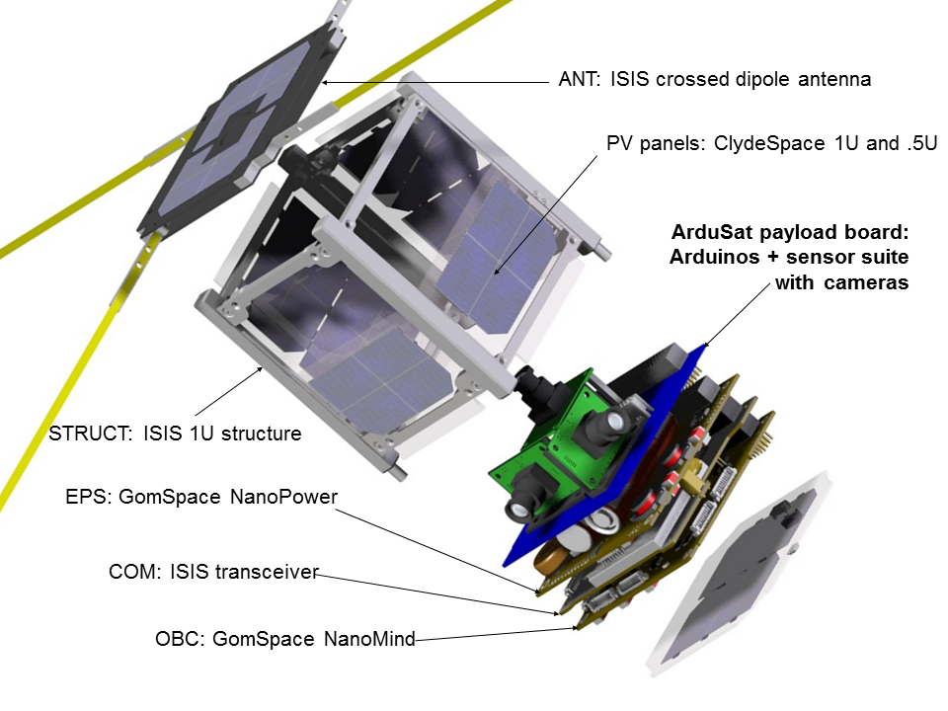
Doing things in space is hard
and highly technical!!

Slide 6
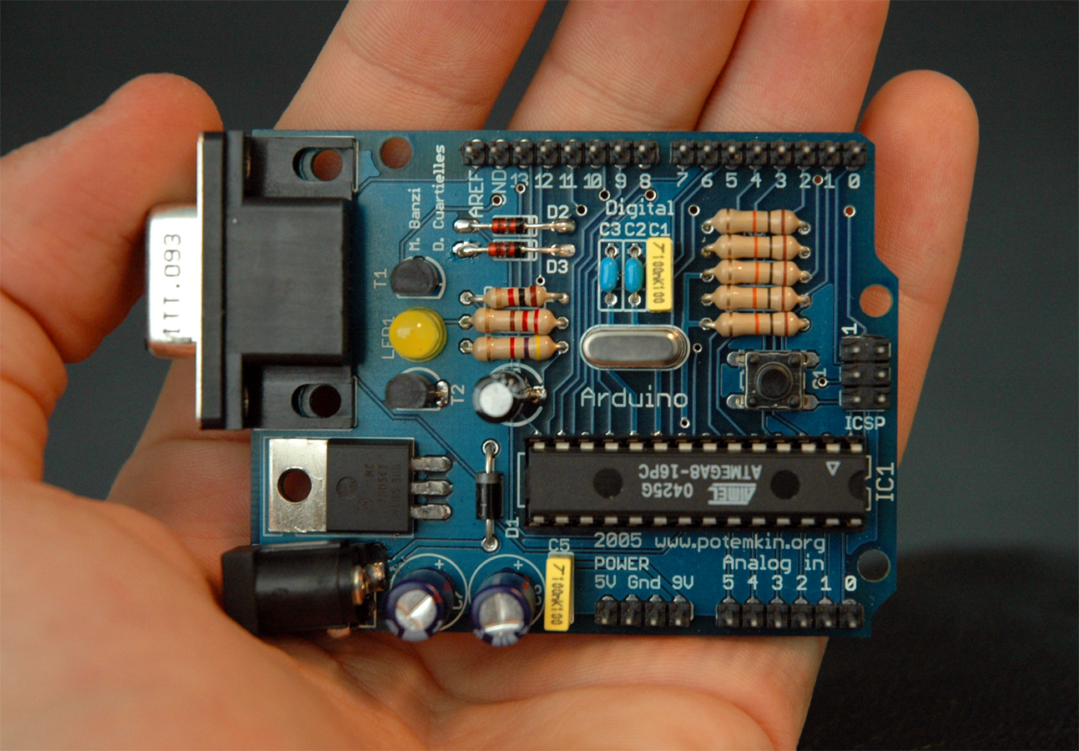
Over 150,000 Arduinos
in the hands of kids, students
and makers…
Notes:
I want to give you an example of Open source Arduino platform which transformed the world of robotics and do it yourself projects since its introduction in 2005. If you were in an engineering school 10 years ago, you could almost get a degree without having to build something…

Slide 7
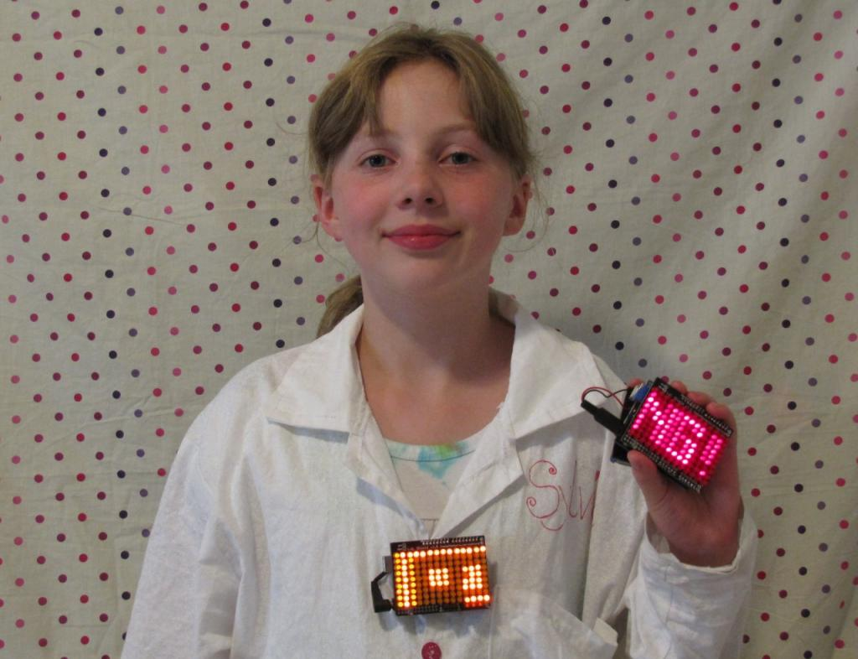
Meet Sylvia.
Notes:
but now with these tools and open source community, even kids as young as 14 have started building creative things with arduino that no one ever thought. Imagine the possibilities when people can do such experiments at their fingertips in matter of few hours.

Slide 8
Rethinking how to enable students
to participate in space
Notes:
So I would like to introduce 3 new products today.

Slide 9
2 Things…
Notes:
So I would like to introduce 3 new products today.

Slide 10
1
Notes:
1

Slide 11
ArduLab is a
NanoRacks compliant and certified,
cubesat form factor,
arduino based
NanoLab purpose designed
for space experiments.
Notes:
What is AduLab, exactly

Slide 12
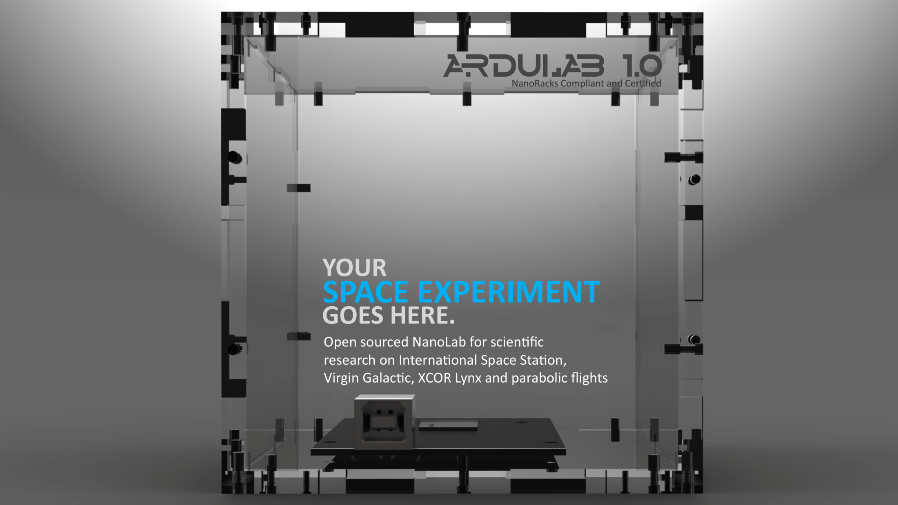
Notes:
When NanoRacks first came out looking for a platform that will allow students and researchers to develop experiments for ISS easier, faster and cheaper, our talented engineering team developed a world’s true open source platform to create scientific experiments. We called it ArduLab.
We are introducing fully autonomous capability in ArduLab to get your data back from International Space Station. Our new ArduLab has automatic switching to experiment and data modes. Now by just specifying how many times you need the ArduLab to switch to a USB drive and push the data out to a computer.
ArduLab now utilizes full resources of Atmega 2560 microcontroller and provides you maximum digital I/O and analog pins for integration innumerous kind of sensors, cameras and modules.

Slide 13
How it Works?

Slide 14
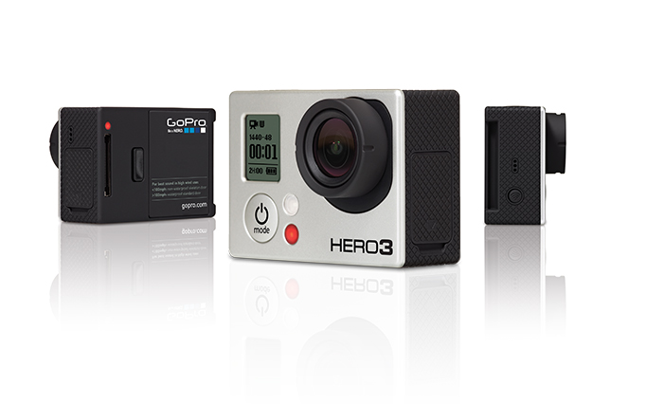
Adding cameras has never been easier
Notes:
What is AduLab, exactly

Slide 15
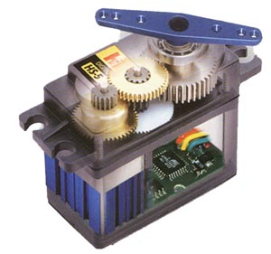
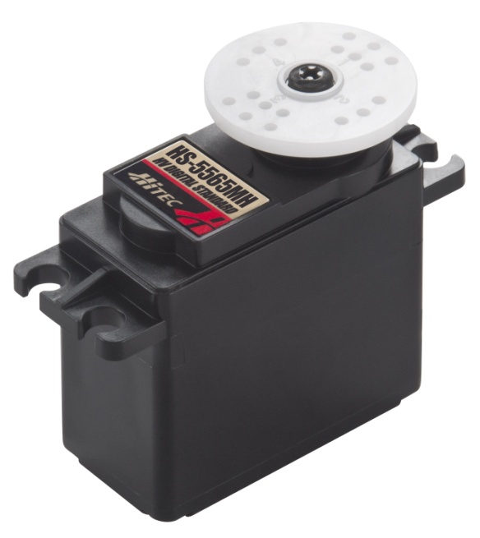
Servos, motors and actuators support
Notes:
What is AduLab, exactly

Slide 16
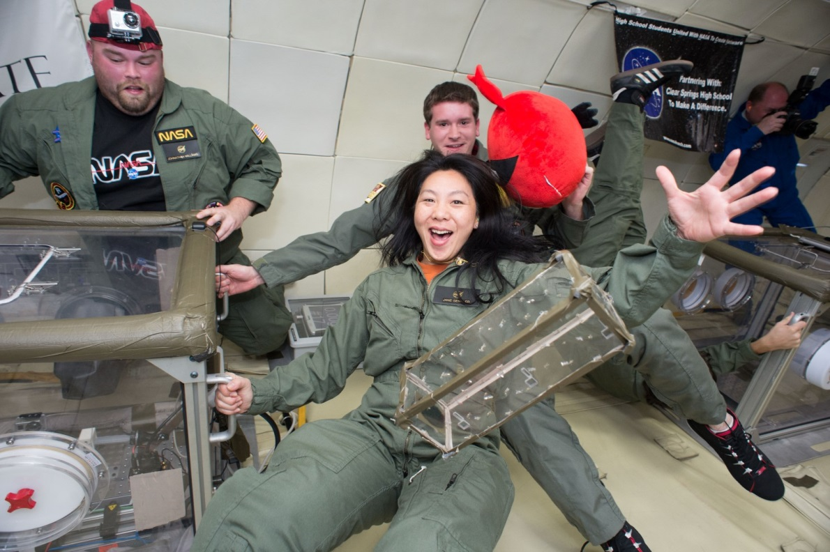
ARDULAB

Slide 17
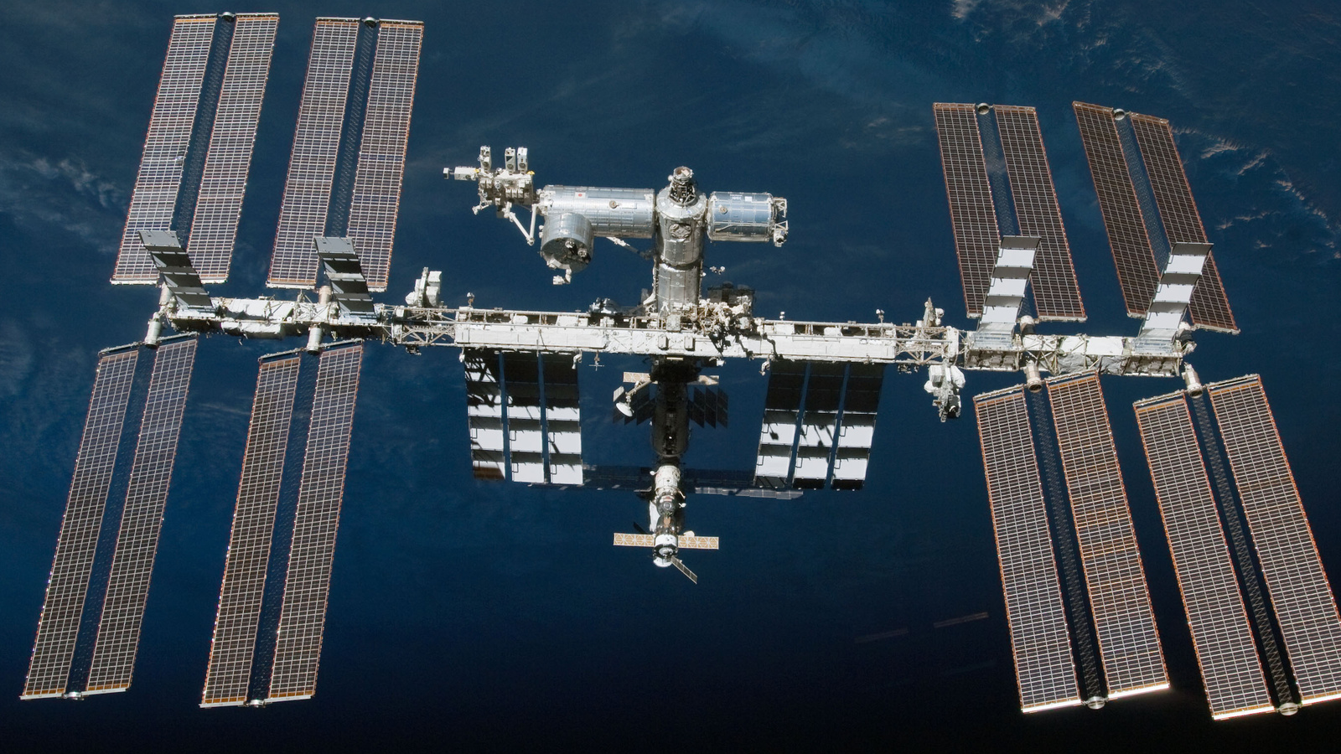
ARDULABS SERVING CUSTOMERS
IN ALL SPACE BOUND VEHICLES
Notes:
ecossystem based on standards
U form factor importance
racks standard accross vehicles

Slide 18
2
Payload Development, Integration and Technical
Services
Notes:
A revolutionary new and easy way to command and observe your experiments while in Space using our Space Cloud Server. You can get your experiment data on your desktop anywhere around the world from your experiments that are orbiting the earth in ISS.

Slide 19
Ardulab
Payload Integration
Technical Support
Help Design Experiments
Rapid Prototyping Services

Slide 20
Schools

Slide 21
Focus on
experiments,
creativity &
innovation
Schools
Ardulabs
Technical support & advice for payloads
Payload Integration
Preparation for flight to space
Rapid Prototyping

Slide 22
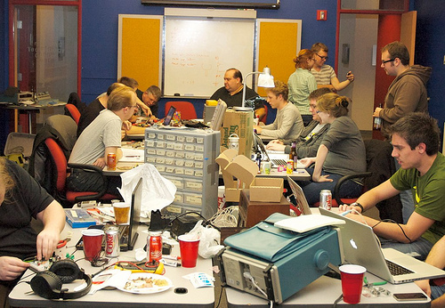
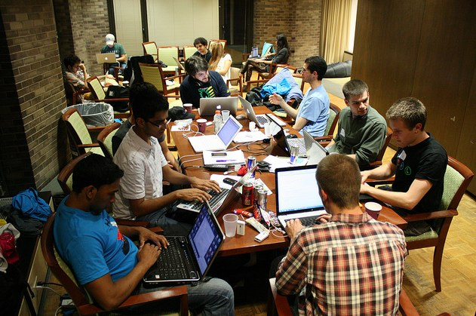
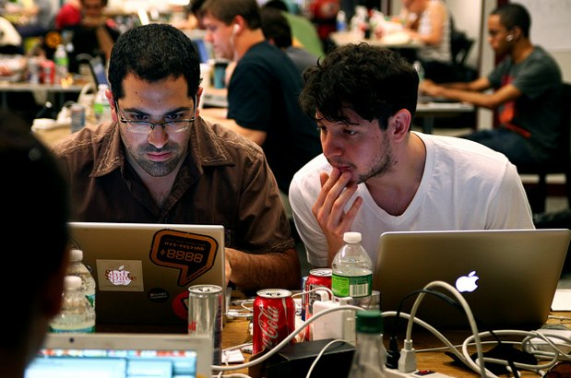
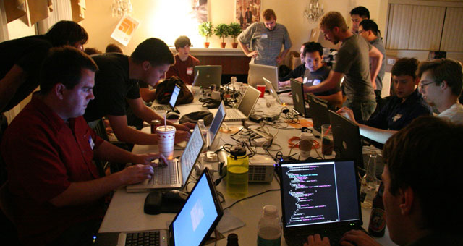
Learning to program Ardulab in 2 days

Slide 23
Enabling a real project based space program
Notes:
So I would like to introduce 3 new products today.

Slide 24
www.infinityaerospace.io
Notes:
This is a day I have been looking forward to since many years. In fact ever since I realized in college that I could not possibly do any experiment or project and get to launch anything in space.

